Slide 1
Simple Secure Storage
vikas

Slide 2
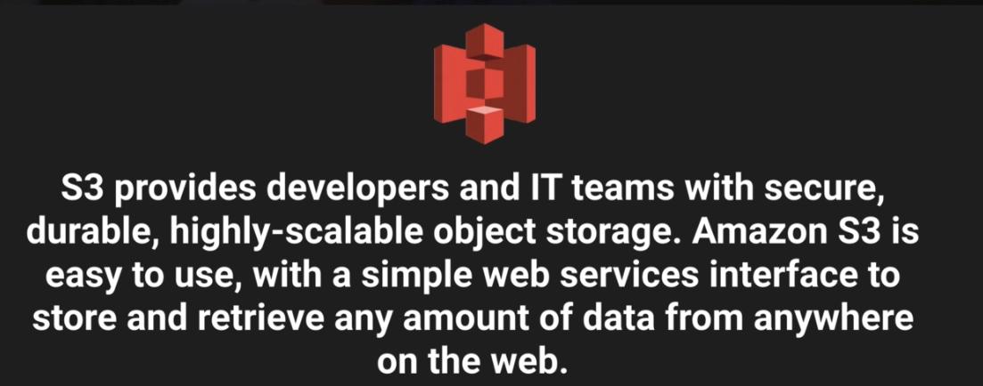
S3 – Simple Secure Storage
Notes:
Safe place to store your files .
Objects based storage(Upload all types of file but not database) .
Data is stored in multiple device and facilities .It can be 0 b to 5 Tb . It has unlimited storage where you pay as per use .
→Read after write consistency for put statement and Eventual(Some time lag) consistency for over write PUTS and DELETE

Slide 3
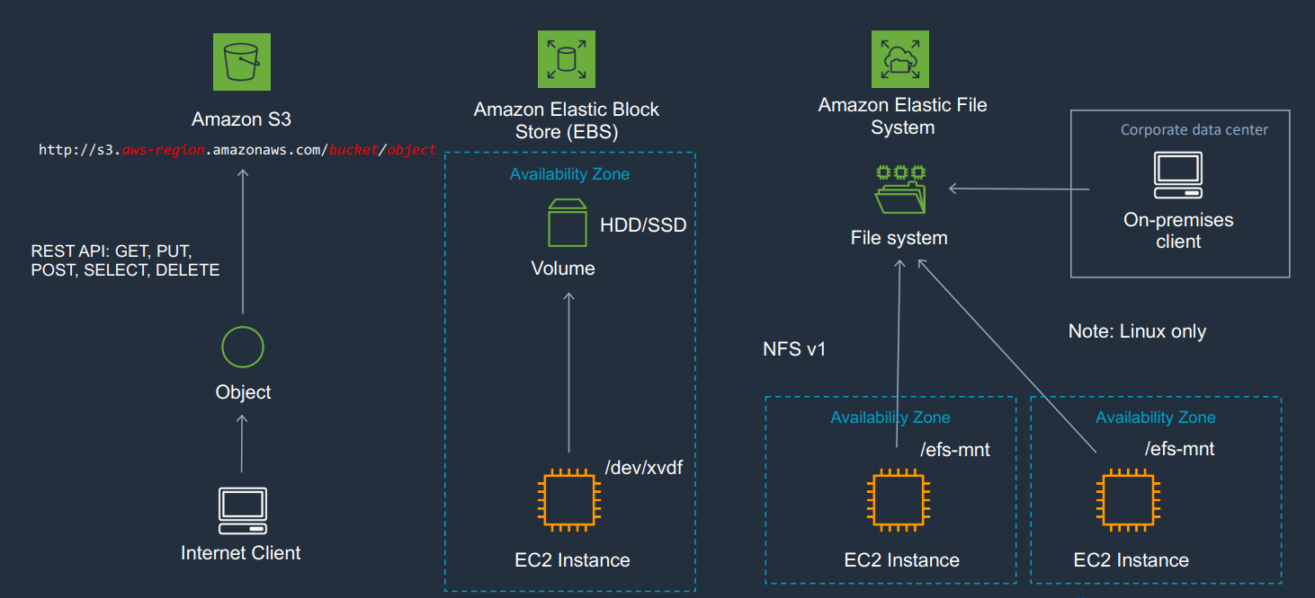

Slide 4
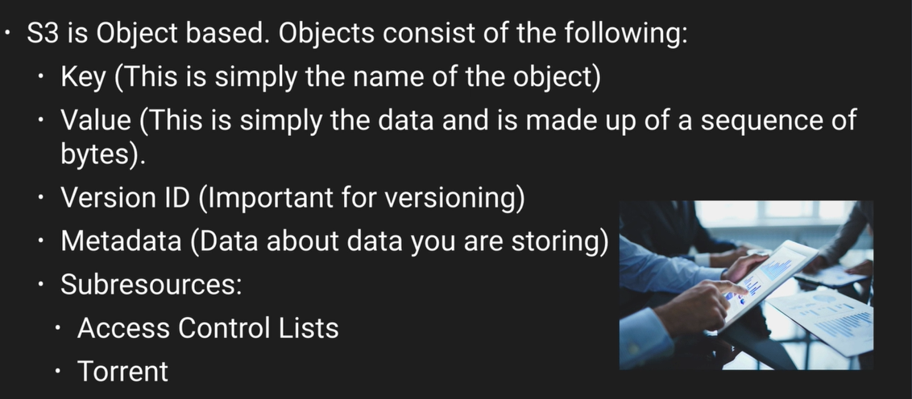
Notes:
Built for 99.99 % availability .
Gives 99.(11*9)% durability (prevention of loss of data)
S3 Core fundamentals are :
Key Value pair
Meta data
Version ID
ACL
By default all newly created bucket are private .You can access bucket control using
ACL – at object level
Bucket policy – entire bucket level

Slide 5
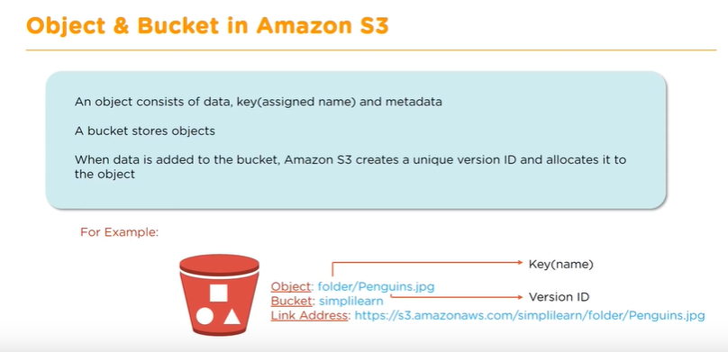
Notes:
Read after write consistency for PUTS of new object -- > Objects immediately available after write is complete
Eventual consistency for overwrite PUTS & DELETES -- > Objects take some time to propagate .

Slide 6
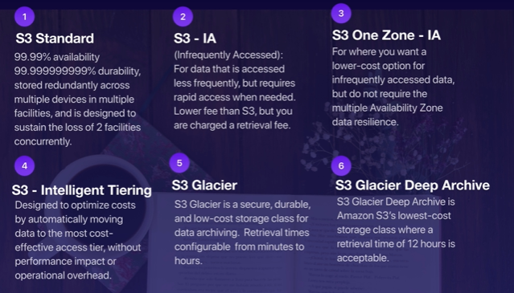
S3 – Storage Tiers /Classes
Notes:
S3 standard doesn't have any retrieval fee .It can sustain failure of 2 facilities concurrently .
S3 One Zone –IA is also called RRS (Reduced Reduncy Storage )
S3 charges for
- storage
Retrieval request
Storage managed pricing (tagging of data)
Data transfer
Transfer accelerator
AWS hosts a variety of public datasets that anyone can access for free.

Slide 7
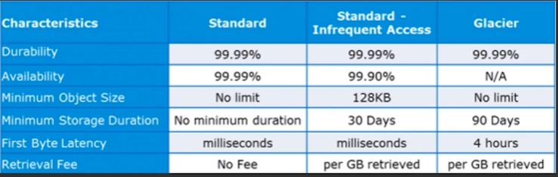
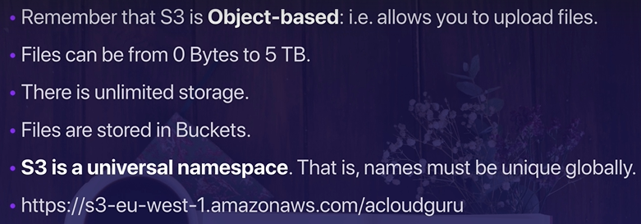

Slide 8
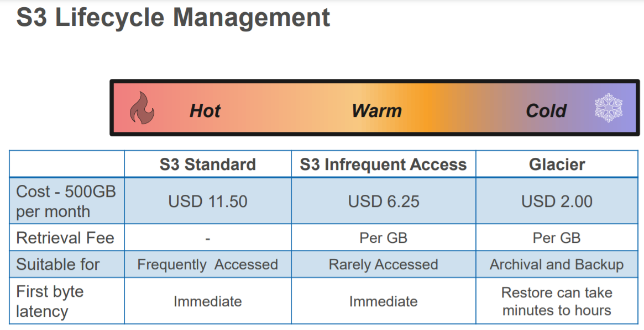
Notes:
Storage Class Analysis “One of the challenges of developing and configuring lifecycle rules for the data lake is gaining an understanding of how data assets are accessed over time.”

Slide 9
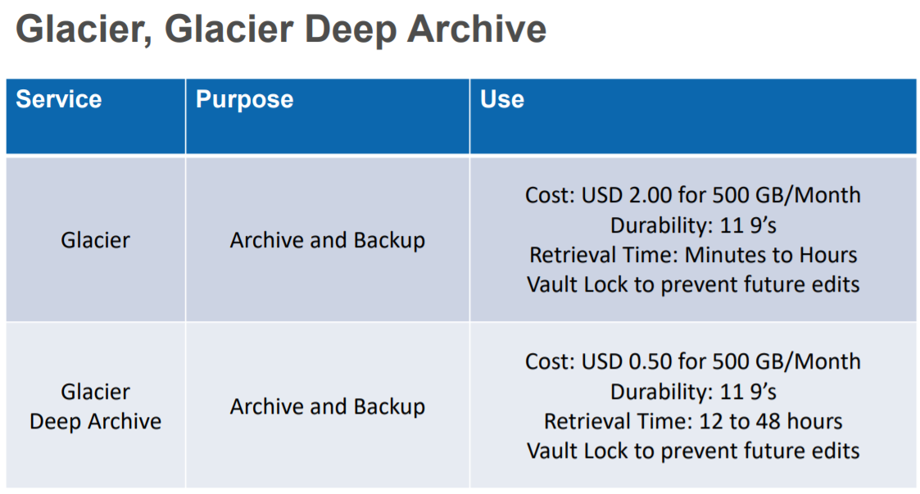

Slide 10
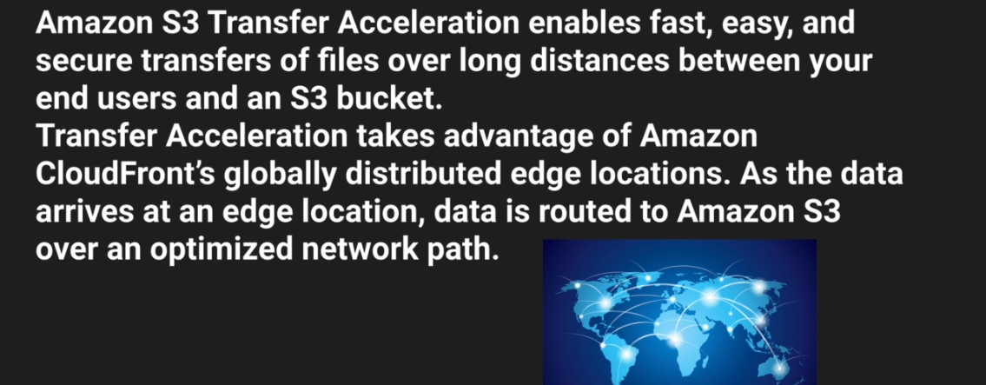
Notes:
Data transfer is done via edge location .. Read S3 FAQ once before exam .
S3 Encryption can be done in two ways :
In Transit which can be achived by SSL/TLS like hhtps request on internet
At Rest
a. (Server side managed by AWS ) – S3 Managed Key SSE-S3
b . AWS key managed services – AWS + Customer share the key
c . Customer provided key
d . Client side encryption .

Slide 11
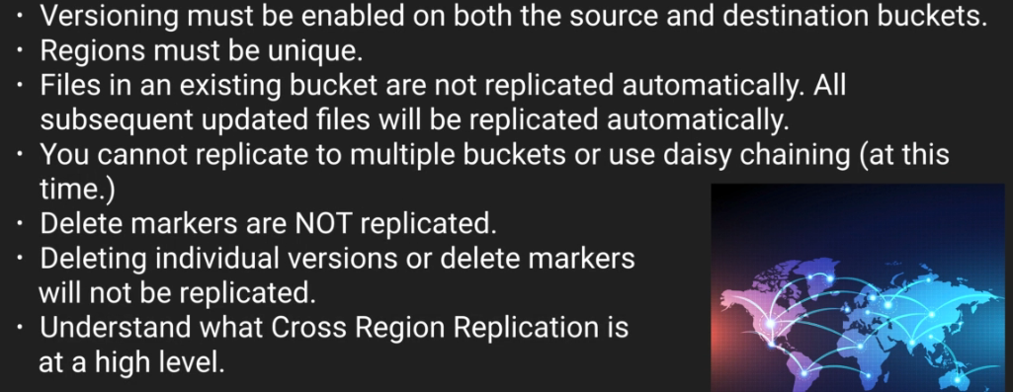
Cross Region Replication/AWS Bucket installer
Notes:
CRR will not automatically copy objects of source bucket to destination bucket . Use AWS bucket installer from google install .Go to command line -> type aws configure then type Access key id & secret access key then region at last .. aws s3 ls to list the bucket list .
aws s3 cp --recursive s3://<source bucket name > s3://<destination bucket name >
Now any changes done to source bucket will automatically will reflect in destination bucket .Changes visible in version tab .But when you delete a object via delete marker or full delete the same will not be replicated in the destination bucket .

Slide 12
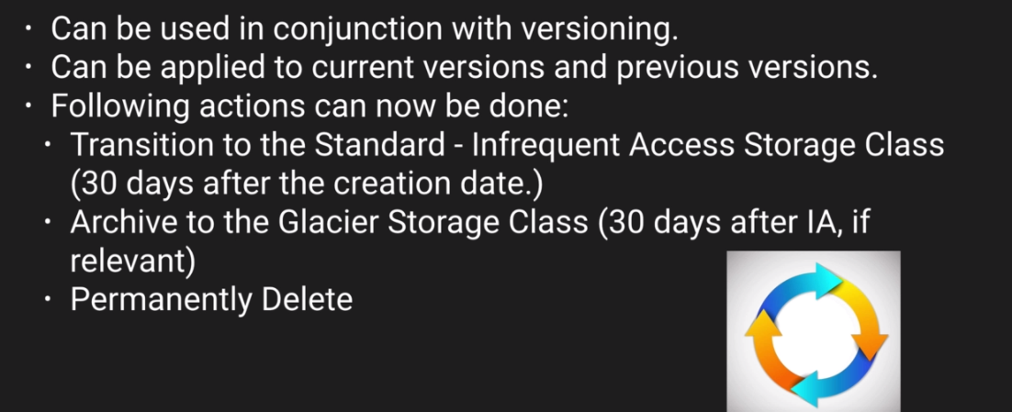
Life cycle Management
Notes:
GO TO Management -> Lifecycle -> Add Lifecycle rules -> say the storage tier rules -> expiration -> create .
You are a solutions architect working for a biotech company who is pioneering research in immunotherapy. They have developed a new cancer treatment that may be able to cure up to 94% of cancers. They store their research data on S3, however recently an intern accidentally deleted some critical files. You've been asked to prevent this from happening in the future. What options below can prevent this? The best answer is to enable S3 versioning on the bucket & enable MFA on the bucket. Versioning is obvious, however by enabling versioning's MFA Delete capability, which uses multi-factor authentication, can be used to provide an additional layer of security.

Slide 13
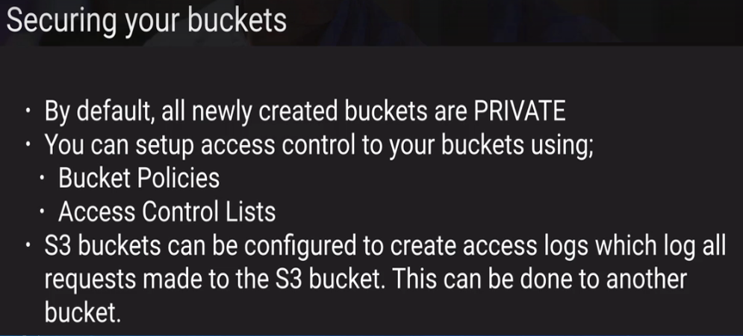
Security & Encryption :
Notes:
While creating a web distribution -> use origin ID to distinguish multiple origin in the same distribution .You can restrict viewer access to cloud front by signed URL or Signed Cookies

Slide 14
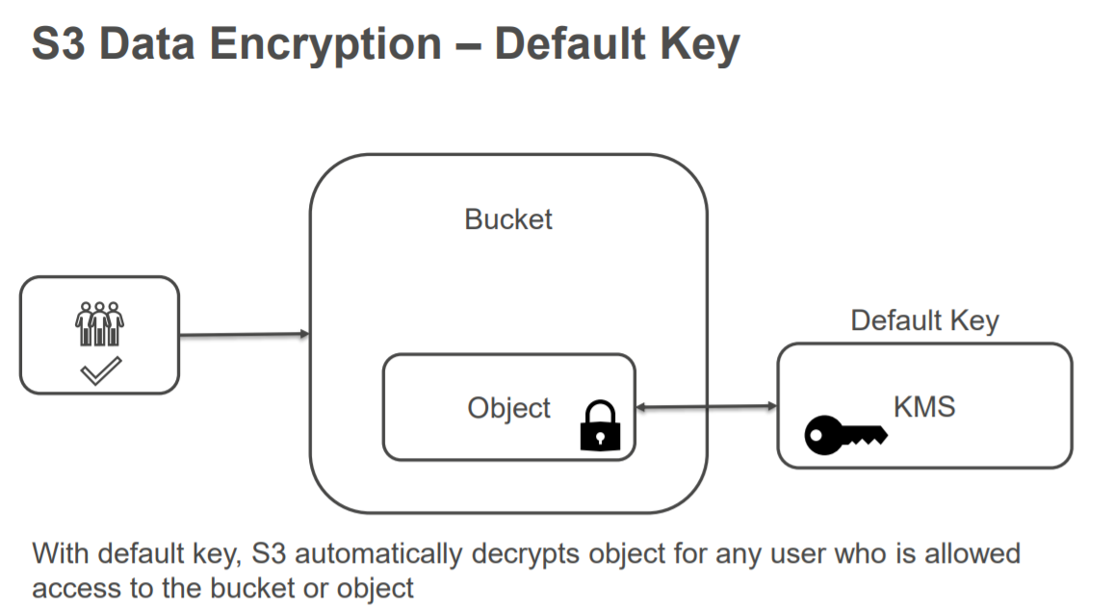
Notes:
Using SAML (Security Assertion Markup Language 2.0), you can give your federated users single sign-on (SSO) access to the AWS Management Console.
Power User Access allows ________. Manage all AWS services except management of group and user in IAM .

Slide 15
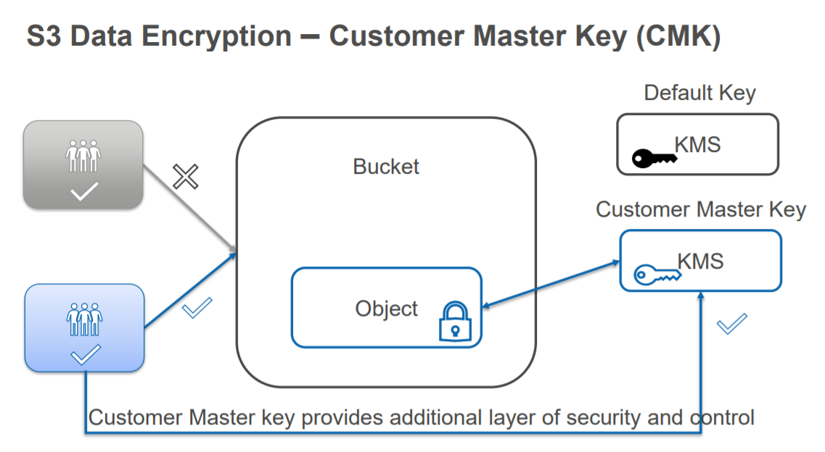
Notes:
Question 18:You have been asked to advise on a scaling concern. The client has an elegant solution that works well. As the information base grows they use CloudFormation to spin up another stack made up of an S3 bucket and supporting compute instances. The trigger for creating a new stack is when the PUT rate approaches 100 PUTs per second. The problem is that as the business grows that number of buckets is growing into the hundreds and will soon be in the thousands. You have been asked what can be done to reduce the number of buckets without changing the basic architecture.
Until 2018 there was a hard limit on S3 puts of 100 PUTs per second. To achieve this care needed to be taken with the structure of the name Key to ensure parallel processing. As of July 2018 the limit was raised to 3500 and the need for the Key design was basically eliminated. Disk IOPS is not the issue with the problem. The account limit is not the issue with the problem.

Slide 16
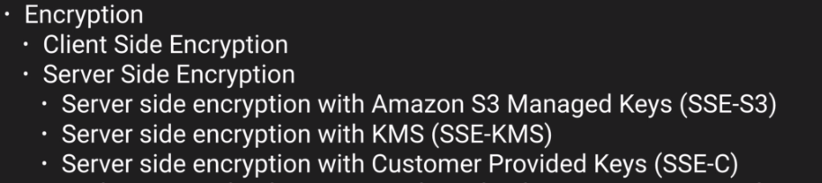
Encryption types :
Create a bucket -> give a unique bucket name -> add tag name .
Access control list will control access at object level but bucket policy will work at bucket level .By default every bucket and object loaded to bucket is private .To make it public go to the properties of the object and click on “Edit Public access setting “ and uncheck every thing .
Notes:
Default encryption should be clicked while creating a bucket .
Once versioning is enabled for a bucket it can only be suspended and not deleted but if you delete the bucket you can delete the version too . To permanently delete a object from a bucket you have to show the version tab and then go to actions and delete it .Else with version hide only a delete marker will be added .Any newly added version will be private by default .You can put MFA delete policy too .

Slide 17
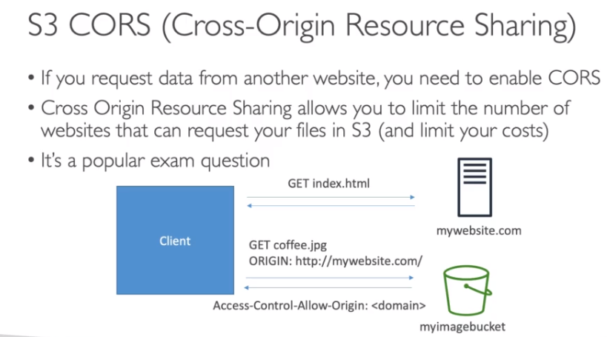

Slide 18
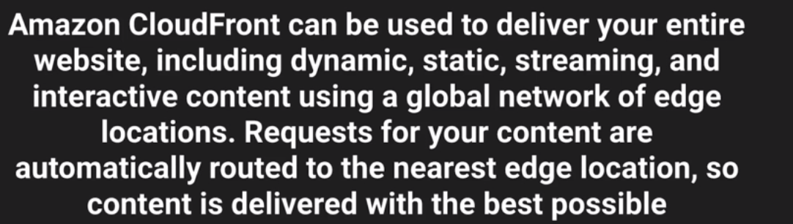
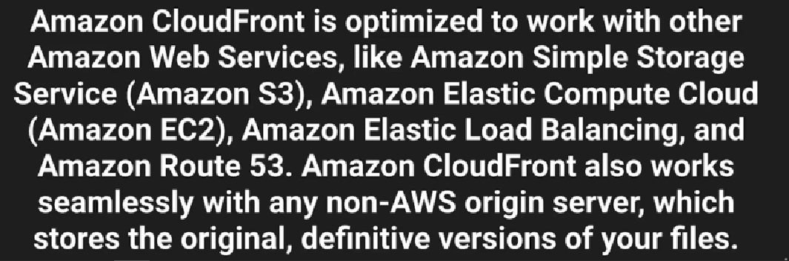
Notes:
There are two types of distribution :
1 .Web Distribution = web site
2 .RTMP = Media distribution
Cloudfront : is a web service that speeds up distribution of your static and dynamic web content , such as .html, .css , .js , and images files to your user .

Slide 19
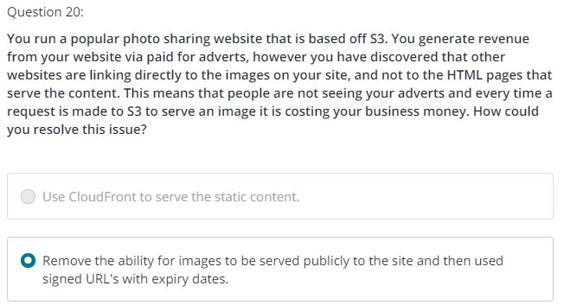
To host a static web site copy the codes to S3 and make the entire bucket public by using bucket policy .
But website which uses a DB connection or dynamic websites can’t be hosted here .
S3 automatically scales up based on the demand .
Notes:
Import/Export Disk allows you to transfer your data directly onto and off of storage devices using amazon high speed internal network and bypassing the internet .
Three type of snowball :
Snowball – On board storage .
Snowball Edge – On board storage + compute capacity .
Snowmobile -

Slide 20
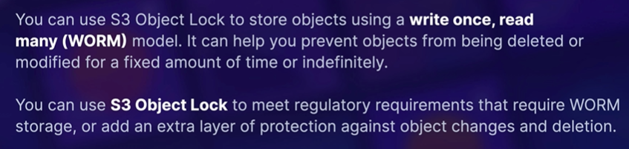
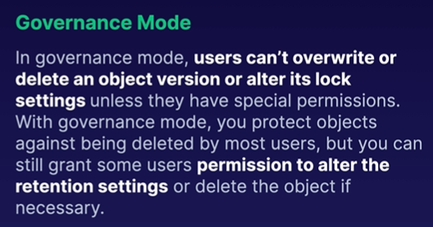
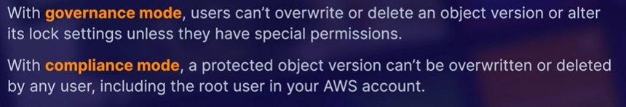
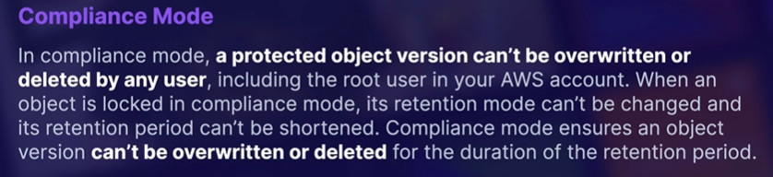

Slide 21
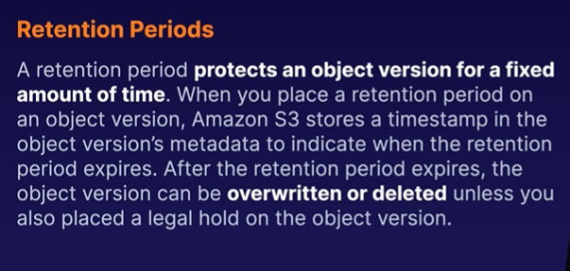
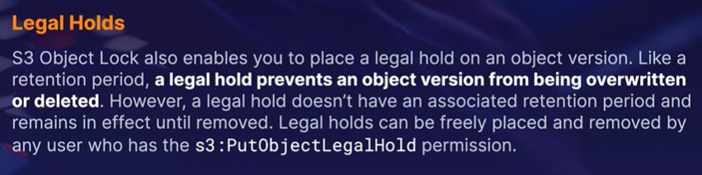
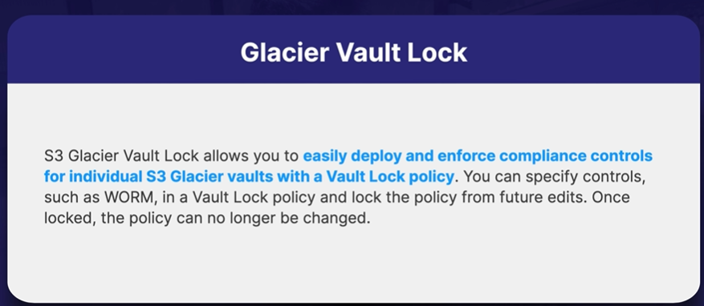

Slide 22
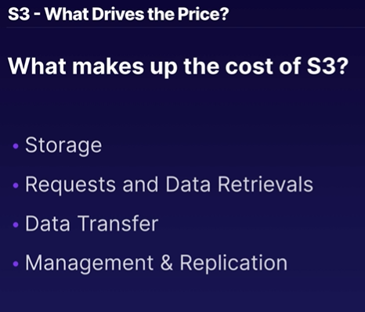
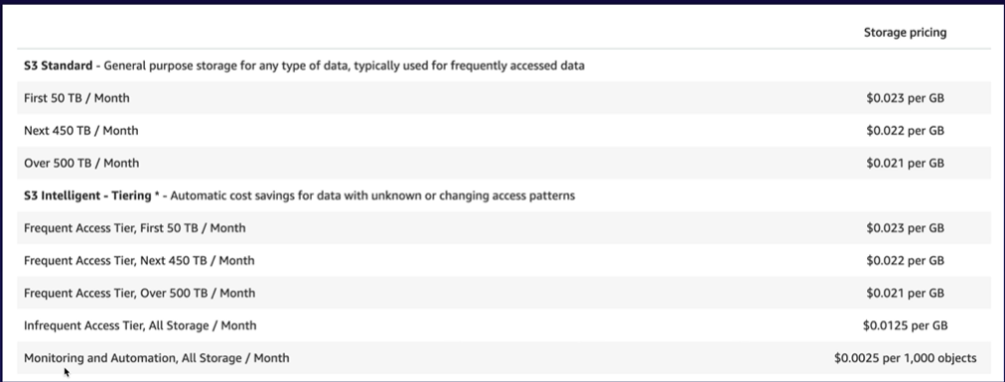

Slide 23
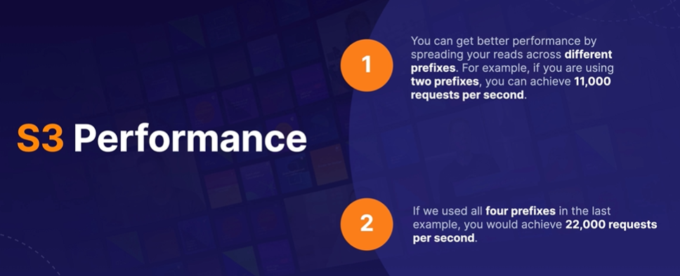
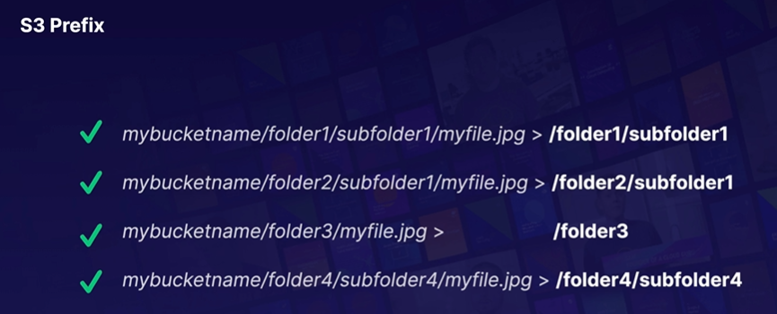

Slide 24
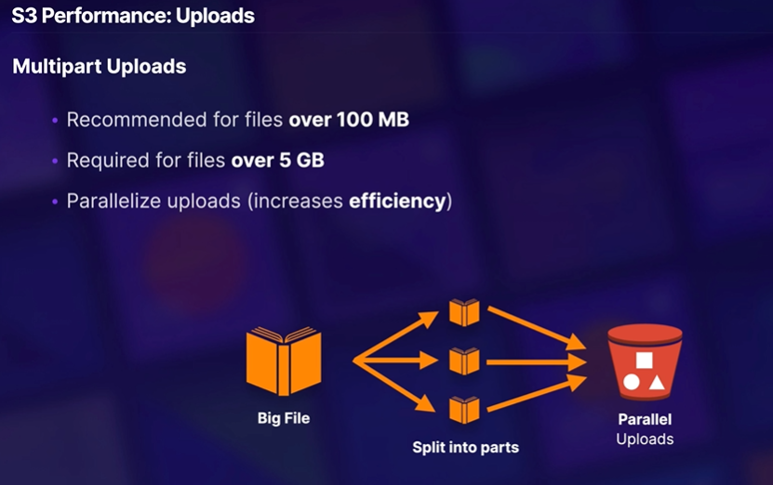

Slide 25
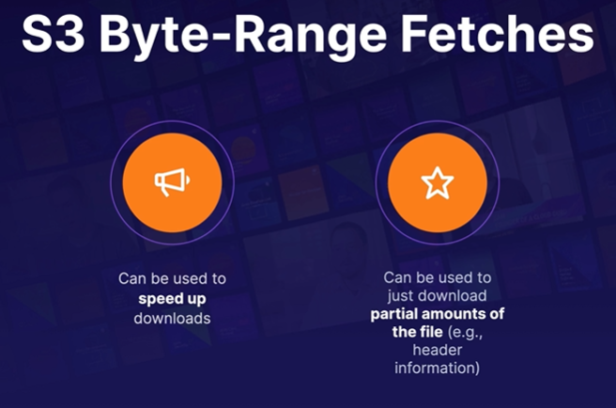
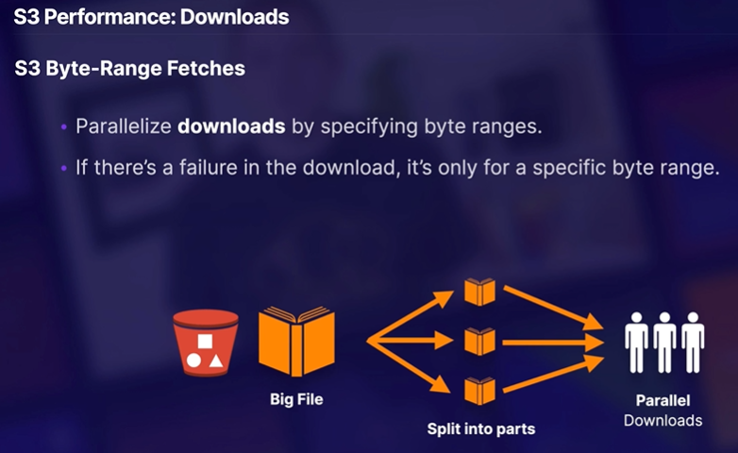

Slide 26
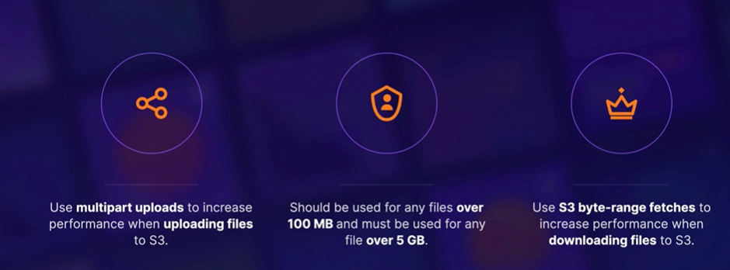
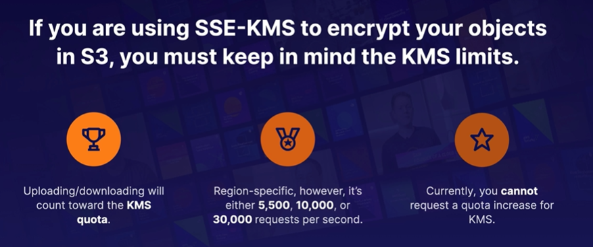

Slide 27
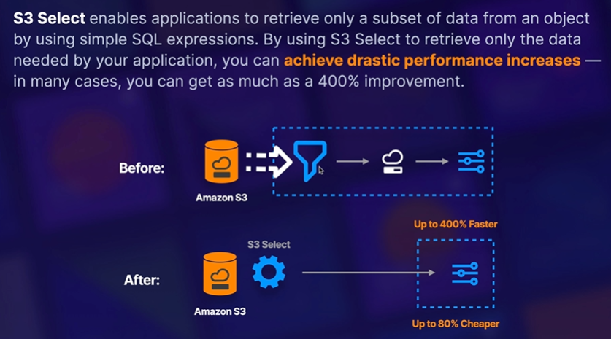

Slide 28
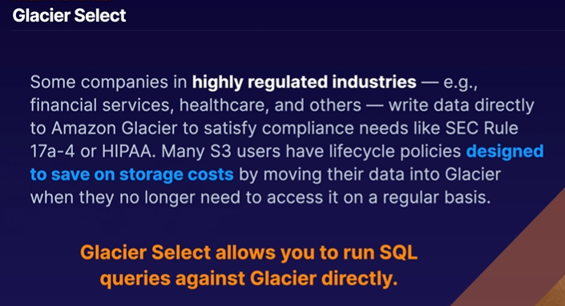

Slide 29
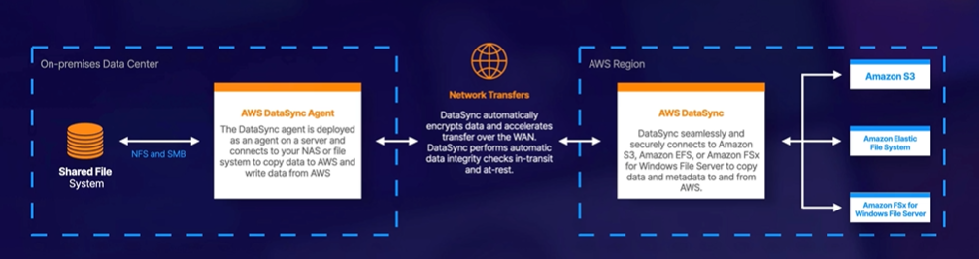
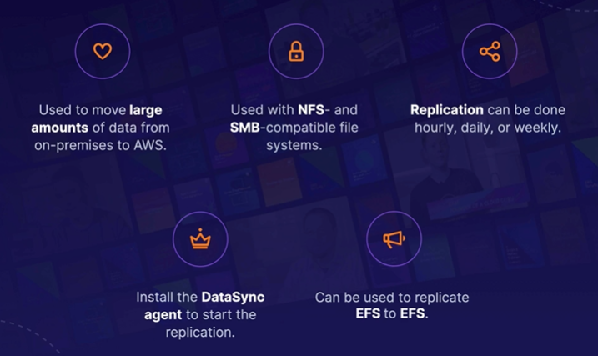
Notes:
Data sync

Slide 30
Hands – on Links for practice :
Day 1 -- https://youtu.be/XAkfJNeSMJA
Day 2 -- https://youtu.be/gbf7Kl83gFQ
Day3 -- https://youtu.be/KYyXi8gtZGs
Notes:
Virtual style puts your bucket name 1st, s3 2nd, and the region 3rd. Path style puts s3 1st and your bucket as a sub domain. Legacy Global endpoint has no region. S3 static hosting can be your own domain or your bucket name 1st, s3-website 2nd, followed by the region. AWS are in the process of phasing out Path style, and support for Legacy Global Endpoint format is limited and discouraged. However it is still useful to be able to recognize them should they show up in logs. https://docs.aws.amazon.com/AmazonS3/latest/dev/VirtualHosting.html

